Slide 1

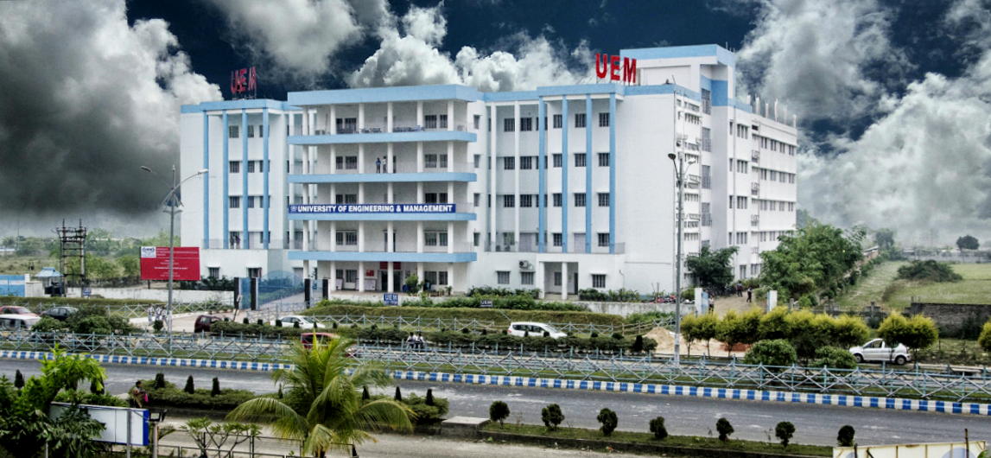
UNIVERSITY OF ENGINEERING & MANAGEMENT, KOLKATA
Course Name : AI & ML

Slide 2
 | UNIVERSITY OF ENGINEERING & MANAGEMENT, KOLKATA
What is Artificial Intelligence?
Anything that makes machines act more intelligently.
Can be called as augmented intelligence.
AI should not attempt to replace human experts, but rather extend human capabilities and accomplish tasks that neither humans nor machines could do on their own.

Slide 3
 | UNIVERSITY OF ENGINEERING & MANAGEMENT, KOLKATA
How do we define intelligence?
Intelligence that governs every activity in our body.
How does AI learn?
The only innate intelligence machines have is what we give them.
Ex: Supervised Learning, Unsupervised Learning and Reinforcement Learning.

Slide 4
 | UNIVERSITY OF ENGINEERING & MANAGEMENT, KOLKATA
History of AI
Maturation of Artificial Intelligence (1943-1952)
Year 1943: The first work which is now recognized as AI was done by Warren McCulloch and Walter pits in 1943. They proposed a model of artificial neurons.
Year 1949: Donald Hebb demonstrated an updating rule for modifying the connection strength between neurons. His rule is now called Hebbian learning.
Year 1950: The Alan Turing who was an English mathematician and pioneered Machine learning in 1950. Alan Turing publishes "Computing Machinery and Intelligence" in which he proposed a test. The test can check the machine's ability to exhibit intelligent behavior equivalent to human intelligence, called a Turing test.

Slide 5
 | UNIVERSITY OF ENGINEERING & MANAGEMENT, KOLKATA
The birth of Artificial Intelligence (1952-1956)
Year 1955: An Allen Newell and Herbert A. Simon created the "first artificial intelligence program "Which was named as "Logic Theorist". This program had proved 38 of 52 Mathematics theorems, and find new and more elegant proofs for some theorems.
Year 1956: The word "Artificial Intelligence" first adopted by American Computer scientist John McCarthy at the Dartmouth Conference. For the first time, AI coined as an academic field.

Slide 6
 | UNIVERSITY OF ENGINEERING & MANAGEMENT, KOLKATA
The golden years-Early enthusiasm (1956-1974)
Year 1966: The researchers emphasized developing algorithms which can solve mathematical problems. Joseph Weizenbaum created the first chatbot in 1966, which was named as ELIZA.
Year 1972: The first intelligent humanoid robot was built in Japan which was named as WABOT-1

Slide 7
 | UNIVERSITY OF ENGINEERING & MANAGEMENT, KOLKATA
A boom of AI (1980-1987)
Year 1980: After AI winter duration, AI came back with "Expert System". Expert systems were programmed that emulate the decision-making ability of a human expert.
In the Year 1980, the first national conference of the American Association of Artificial Intelligence was held at Stanford University.

Slide 8
 | UNIVERSITY OF ENGINEERING & MANAGEMENT, KOLKATA
The emergence of intelligent agents (1993-2011)
Year 1997: In the year 1997, IBM Deep Blue beats world chess champion, Gary Kasparov, and became the first computer to beat a world chess champion.
Year 2002: for the first time, AI entered the home in the form of Roomba, a vacuum cleaner.
Year 2006: AI came in the Business world till the year 2006. Companies like Facebook, Twitter, and Netflix also started using AI.

Slide 9
 | UNIVERSITY OF ENGINEERING & MANAGEMENT, KOLKATA
Deep learning, big data and artificial general intelligence (2011-present)
Year 2011: In the year 2011, IBM's Watson won jeopardy, a quiz show, where it had to solve the complex questions as well as riddles. Watson had proved that it could understand natural language and can solve tricky questions quickly.
Year 2012: Google has launched an Android app feature "Google now", which was able to provide information to the user as a prediction.
Year 2014: In the year 2014, Chatbot "Eugene Goostman" won a competition in the infamous "Turing test."
Year 2018: The "Project Debater" from IBM debated on complex topics with two master debaters and also performed extremely well.

Slide 10
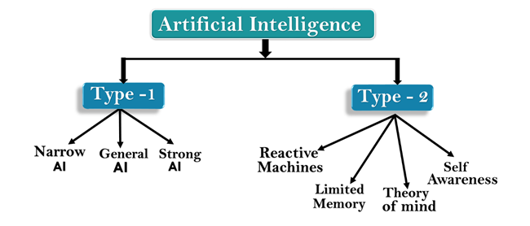
 | UNIVERSITY OF ENGINEERING & MANAGEMENT, KOLKATA

Slide 11
 | UNIVERSITY OF ENGINEERING & MANAGEMENT, KOLKATA
Weak AI or Narrow AI:
Narrow AI is a type of AI which is able to perform a dedicated task with intelligence. The most common and currently available AI is Narrow AI in the world of Artificial Intelligence. Narrow AI cannot perform beyond its field or limitations, as it is only trained for one specific task. Hence it is also termed as weak AI. Narrow AI can fail in unpredictable ways if it goes beyond its limits.
Example: Apple Siriis , IBM's Watson supercomputer are playing chess, purchasing suggestions on e-commerce site, self-driving cars, speech recognition, and image recognition.

Slide 12
 | UNIVERSITY OF ENGINEERING & MANAGEMENT, KOLKATA
General AI:
General AI is a type of intelligence which could perform any intellectual task with efficiency like a human. The idea behind the general AI to make such a system which could be smarter and think like a human by its own.
Currently, there is no such system exist which could come under general AI and can perform any task as perfect as a human.

Slide 13
 | UNIVERSITY OF ENGINEERING & MANAGEMENT, KOLKATA
Super AI:
Super AI is a level of Intelligence of Systems at which machines could surpass human intelligence, and can perform any task better than human with cognitive properties. It is an outcome of general AI.
Some key characteristics of strong AI include capability include the ability to think, to analyze, solve the puzzle, make judgments, plan, learn, and communicate by its own.

Slide 14
 | UNIVERSITY OF ENGINEERING & MANAGEMENT, KOLKATA
Reactive Machines
Such AI systems do not store memories or past experiences for future actions.
These machines only focus on current scenarios and react on it as per possible best action.
IBM's Deep Blue system is an example of reactive machines.

Slide 15
 | UNIVERSITY OF ENGINEERING & MANAGEMENT, KOLKATA
Limited Memory
Limited memory machines can store past experiences or some data for a short period of time.
These machines can use stored data for a limited time period only.
Self-driving cars are one of the best examples of Limited Memory systems. These cars can store recent speed of nearby cars, the distance of other cars, speed limit, and other information to navigate the road.

Slide 16
 | UNIVERSITY OF ENGINEERING & MANAGEMENT, KOLKATA
Theory of Mind
Theory of Mind AI should understand the human emotions, people, beliefs, and be able to interact socially like humans. This type of AI machines are still not developed, but researchers are making lots of efforts and improvement for developing such AI machines.
Self-Awareness
Self-awareness AI is the future of Artificial Intelligence. These machines will be super intelligent, and will have their own consciousness, sentiments, and self-awareness.

Slide 17
 | UNIVERSITY OF ENGINEERING & MANAGEMENT, KOLKATA
What can be called AI Problem?
Problems with high time complexity
Not having simple mathematical / logical solutions
Classical AI problem example: puzzle problem, water jug problem, n-Queen

Slide 18
 | UNIVERSITY OF ENGINEERING & MANAGEMENT, KOLKATA
How to solve a problem?
Use AI algorithm OR mix of AI and non AI algorithm
What is AI algorithm?
Non-conventional intuitive approach for problem solving like intelligent search problem.
How search algorithm works? From an arbitrary start state reach a goal state
What is a state? state represents a status of the solution at a given step of the problem solving procedure. The solution of a problem, thus, is a collection of the problem states.

Slide 19
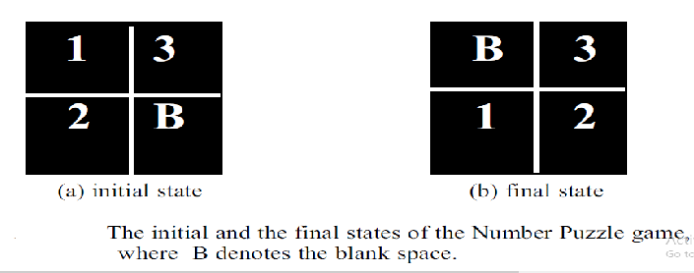
 | UNIVERSITY OF ENGINEERING & MANAGEMENT, KOLKATA

Slide 20
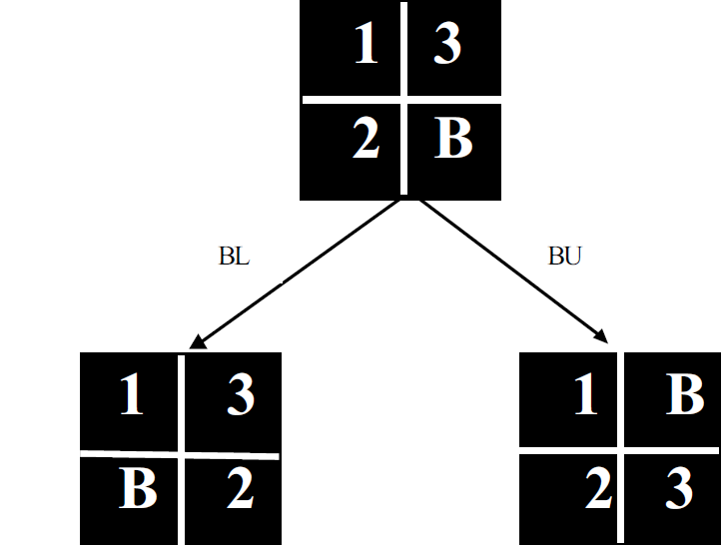
 | UNIVERSITY OF ENGINEERING & MANAGEMENT, KOLKATA

Slide 21
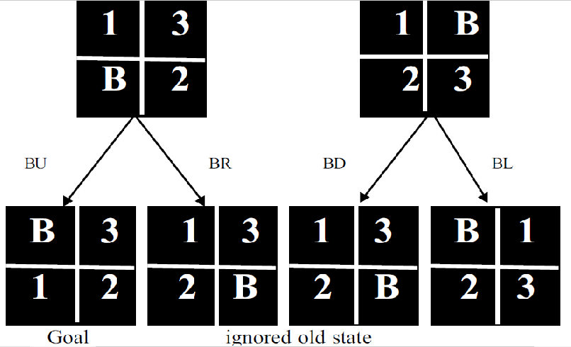
 | UNIVERSITY OF ENGINEERING & MANAGEMENT, KOLKATA

Slide 22
 | UNIVERSITY OF ENGINEERING & MANAGEMENT, KOLKATA
Target of the algorithm?
Find the solution using lesser number of states
Finding right formula which can help to find more promising state

Slide 23
 | UNIVERSITY OF ENGINEERING & MANAGEMENT, KOLKATA
Some well known Intelligent Search Algorithms:
a)Generate and Test
b) Hill Climbing
c) Heuristic Search
d) Means and Ends analysis

Slide 24
 | UNIVERSITY OF ENGINEERING & MANAGEMENT, KOLKATA
a)Generate and Test : This approach concerns the generation of the state-space from a known starting state (root) of the problem and continues expanding the reasoning space until the goal node or the terminal state is reached.

Slide 25
 | UNIVERSITY OF ENGINEERING & MANAGEMENT, KOLKATA
b) Hill Climbing : At first select a starting state and calculate the cost for reaching goal state. If this cost is lesser than some predefined value and goal is not reached then child nodes are created and process is continued. But, if cost become identical for different nodes, then restart the process by selecting some other node as starting node.

Slide 26
 | UNIVERSITY OF ENGINEERING & MANAGEMENT, KOLKATA
c) Heuristic Search : Heuristic function is used to find better candidate states among all legal states.
d) Means and Ends analysis: This method of search attempts to reduce the gap between the current state and the goal state. One simple way to explore this method is to measure the distance between the current state and the goal, and then apply an operator to the current state, so that the distance between the resulting state and the goal is reduced.

Slide 27
 | UNIVERSITY OF ENGINEERING & MANAGEMENT, KOLKATA
Agent : This is a part of a AI system which can communicate with environment. It may be software or hardware or mix of both.
Types of Agents:
Simple Reflex Agents (act only on the basis of the current percept)
Model-Based Reflex Agents (The agent has to keep track of the internal state which is adjusted by each percept and that depends on the percept history.)
Goal-Based Agents (These kinds of agents take decisions based on how far they are currently from their goal(description of desirable situations). Their every action is intended to reduce its distance from the goal. )
Utility-Based Agents(When there are multiple possible alternatives, then decide which one is best)
Learning Agent ( learn from its past experiences)

Slide 28
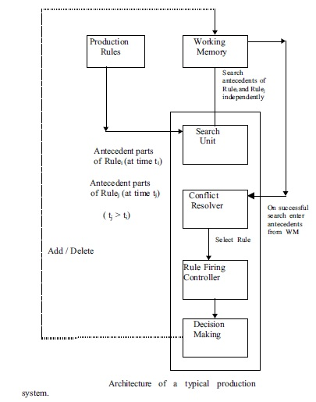
 | UNIVERSITY OF ENGINEERING & MANAGEMENT, KOLKATA

Slide 29
 | UNIVERSITY OF ENGINEERING & MANAGEMENT, KOLKATA
Knowledge Representation
Production system is the oldest technique for knowledge representation
Production system includes -
a knowledge base, represented by production rules
a working memory to hold the matching patterns of data
an interpreter, also called the inference engine, that decides which rule to apply, when more than one of them are concurrently applicable.

Slide 30
 | UNIVERSITY OF ENGINEERING & MANAGEMENT, KOLKATA
Production Rules
The structure of a production rule PR1 can be formally stated as follows:
PR1: P1 (X) Λ P2 (Y) Λ .. Pn (X, Z) → Q1 (Y) V Q2 (Z) V .. Qm (Y, X)
Where, Λ is for logical AND
V is for logical OR
→ is for ‘if-then’
Left side of the PR is called ‘antecedent’ (P) and right side is called ‘consequent’ (Q)
P & Q may be predicate or may be represented as a triplet of Object-Attribute-Value.

Slide 31
 | UNIVERSITY OF ENGINEERING & MANAGEMENT, KOLKATA
The working memory (WM)
It generally holds data either in the form of clauses or object-attribute-value (OAV) triplet form.
On the basis of the variables value present in the ‘P’ part a search operation is done and if a proper match can be found a rule is being fired.

Slide 32
 | UNIVERSITY OF ENGINEERING & MANAGEMENT, KOLKATA
The Control Unit / Interpreter
Consists of 3 steps, together is called Recognize-Act Cycle.
Step 1: Match the variables of the antecedents of a rule, kept in a knowledge base, with the data recorded in the WM.
Step 2. If more than one rule, which could fire, is available then decide which rule to fire by designing a set of strategies for resolving the conflict regarding firing of the rules.
3. After firing of a rule, add new data items to WM or delete old (and unnecessary) data, as suggested by the fired rule from the WM and go to step (1).
Generally, a start-up element is kept at the working memory at the beginning and computation process is terminated if no rule fires or the fired rule contains an explicit command to halt.
If only one rule is there at any instance for a system, then it is deterministic, otherwise non deterministic.
Performance of a control unit / interpreter depends on two properties, namely,
i) Sensitivity: if the system can respond quickly to the change in environment, reflected by the new contents of the WM
ii) Stability: showing continuity in the line of reasoning.

Slide 33
 | UNIVERSITY OF ENGINEERING & MANAGEMENT, KOLKATA
Conflict Resolution Strategies
Most common strategies are:-
Refractoriness: Same rule should not be fired more than once when instantiated with the same set of data.
Recency: Most recent elements of the WM be used up for instantiating one of the rules
Specificity: Rule with more number of antecedent clauses be fired than rules handling fewer antecedent clauses.

Slide 34
 | UNIVERSITY OF ENGINEERING & MANAGEMENT, KOLKATA
Forward versus Backward Production Systems
In Forward system start state & goal state is known. Problem solver has to identify the states which can reach to goal.
In Backward System start state is unknown, but goal state is known.

Slide 35
 | UNIVERSITY OF ENGINEERING & MANAGEMENT, KOLKATA
Case Study
Problem 1: Given 2 water jugs, 4 liters and 3 liters. Neither has any measuring marks on it. There is a pump that can be used to fill the jugs. How can you get exactly 2 liters of water into 4-liter jugs?
Problem 2: A farmer wants to transfer his three belongings, a wolf, a goat and a cabbage, by a boat from the left bank of a river to its right bank. The boat can carry at most two items including the farmer. If unattended, the wolf may eat up the goat and the goat may eat up the cabbage. How should the farmer plan to transfer the items?

Slide 36
 | UNIVERSITY OF ENGINEERING & MANAGEMENT, KOLKATA
Sl No | State | Condition | State | Description
1 | (x,y) | If x<4 | (4,y) | Fill the 4 ltr jug completely
2 | (x,y) | if y<3 | (x,3) | Fill the 3 ltr jug completely
3 | (x,y) | If x>0 | (x-d,y) | Pour some part from the 4 ltr jug
4 | (x,y) | If y>0 | (x,y-d) | Pour some part from the 3 ltr jug
5 | (x,y) | If x>0 | (0,y) | Empty the 4 ltr jug

Slide 37
 | UNIVERSITY OF ENGINEERING & MANAGEMENT, KOLKATA
Sl No | State | Condition | State | Description
6 | (x,y) | If y>0 | (x,0) | Empty the 3 ltr jug
7 | (x,y) | If (x+y)<7 | (4, y-[4-x]) | Pour some water from the 3 ltr jug to fill the four ltr jug
8 | (x,y) | If (x+y)<7 | (x-[3-y],y) | Pour some water from the 4 ltr jug to fill the 3 ltr jug.
9 | (x,y) | If (x+y)<4 | (x+y,0) | Pour all water from 3 ltr jug to the 4 ltr jug
10 | (x,y) | if (x+y)<3 | (0, x+y) | Pour all water from the 4 ltr jug to the 3 ltr jug

Slide 38
 | UNIVERSITY OF ENGINEERING & MANAGEMENT, KOLKATA
S.No. | 4 gallon jug contents | 3 gallon jug contents | Rule followed
1. | 0 gallon | 0 gallon | Initial state
2. | 0 gallon | 3 gallons | Rule no.2
3. | 3 gallons | 0 gallon | Rule no. 9
4. | 3 gallons | 3 gallons | Rule no. 2
5. | 4 gallons | 2 gallons | Rule no. 7
6. | 0 gallon | 2 gallons | Rule no. 5
7. | 2 gallons | 0 gallon | Rule no. 9
Solution of water jug problem according to the production rules

Slide 39
 | UNIVERSITY OF ENGINEERING & MANAGEMENT, KOLKATA
Production rule to problem 2
PR 1: (F, G, W, C | | Nil ) → ( W, C | | F, G)
PR 2: (W, C | | F, G) → ( F, W, C | | G)
PR 3: (F, W, C | | G) → (C | | F, W, G)
PR 4: (C | | F, W, G) → ( F, G, C | | W)
PR5: (F, G, C | | W) → (G | | F, W, C)
PR 6: ( G | | F, W, C) → ( F, G | | W, C)
PR 7: ( F, G, | | W, C) → ( Nil | | F,G, W, C)
PR 8 ( F, W, C | | G) → ( W | | F, G, C)
PR 9: ( W | | F, G, C) → ( F, G, W | | C)
PR 10: ( F, G, W | | C) → ( G | | F, W, C)
PR 11: ( G | | F, W, C) → ( F, G | | W,C)
PR 12: ( F, G | | W, C) →( Nil | | F, G, W, C)

Slide 40

 | UNIVERSITY OF ENGINEERING & MANAGEMENT, KOLKATA
Thank You

